Slide 1
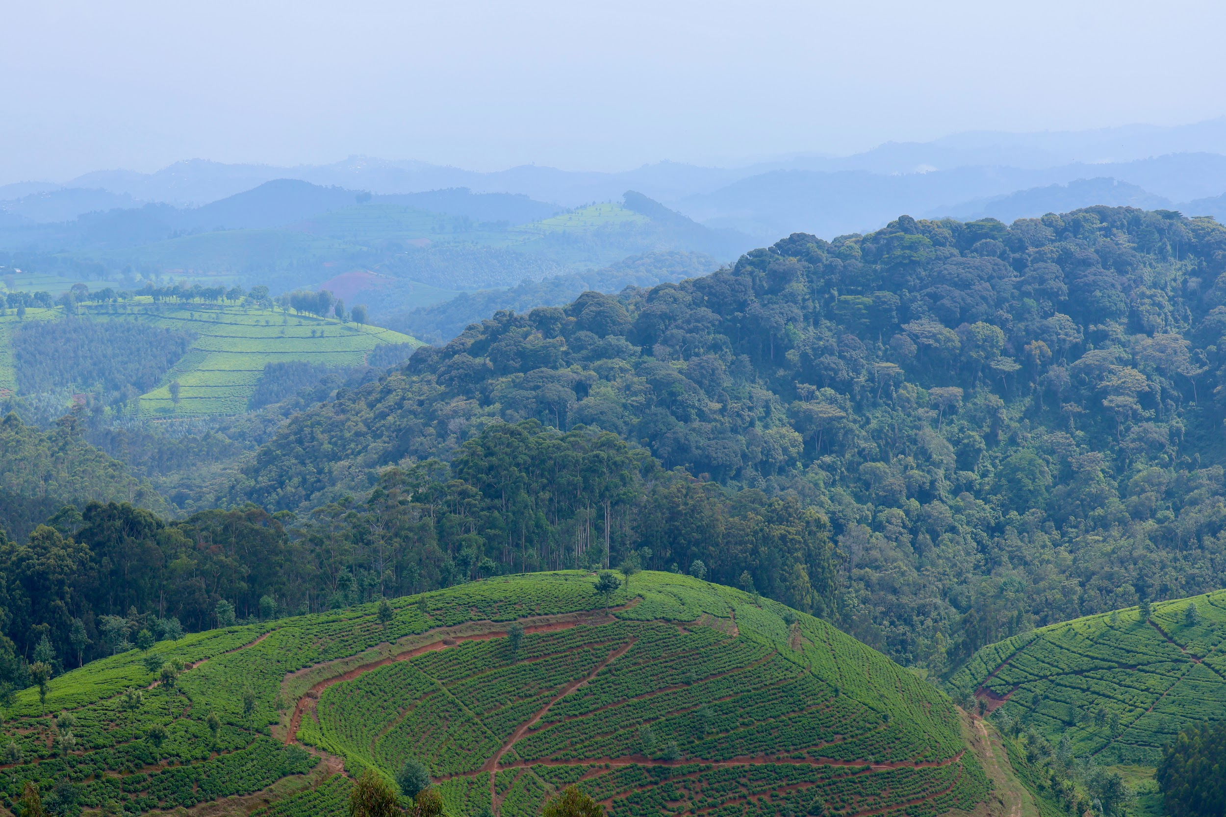
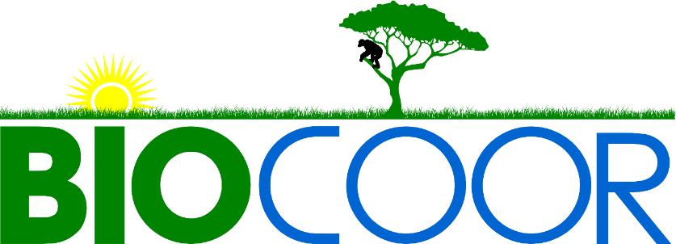
Capacity Statement
About BIOCOOR
Biodiversity Conservation Organization, or BIOCOOR, is a youth-led, local, non-profit organization operating in the Southern Province of Rwanda. The organization acts and advocates for biodiversity conservation, community health, and climate change mitigation and adaptation by focusing on the sustainable economic development of the communities surrounding Nyungwe National Park and Lake Kivu.
The Problem
Organizational History
Nyungwe National Park (NNP) is one of oldest rainforests in Africa. It is home to 322 bird species, 120 species of butterfly, 77 species of mammals, and 12 species of primates, many of these species are endemic to the Albertine Rift area. Nyungwe National Park is recognized as a UNESCO World Heritage Site. The plentiful rainfall in the park is responsible for 70% of Rwanda’s total water supply.
Many threats to the park exist and persist. Local communities surrounding Nyungwe National Park and Lake Kivu are among the poorest in Rwanda. Poor farming conditions due to acidic soil mean that these communities must resort to illegal activities, such as poaching and deforestation in the park and on the islands of Lake Kivu as a means to survive. Human intervention is the greatest threat to flora and fauna in this area.
BIOCOOR began in 2012 as a social enterprise called BIOCOOP. In 2020, the organization shifted into an non-governmental organization, keeping the same focus. BIOCOOR was founded primarily by young people dedicated to act and advocate for biodiversity conservation, ecotourism promotion, community health, environmental management, and climate change mitigation and adaptation. The BIOCOOR headquarters are in Huye district of the Southern Province of Rwanda. The organization’s geographic focus are the five districts near Nyungwe National Park: Rusizi, Nyamasheke, Karongi, Nyamagabe, and Nyaruguru, plus Huye, Nyanza, and Gisagara districts. The primary target for BIOCOOR’s conservation activities is the rainforests of Nyungwe National Park, its buffer zone, Lake Kivu, and Rusizi river basin. BIOCOOR aims to integrate conservation projects and sustainable economic development in both green and blue economies.
Mission:
To build a nation that is environmentally and socio-economically stable through its resources and skills.
Vision:
Contribute to the development of Rwanda to the level of middle-income countries using its resources and skills.
Our Programs
Community Conservation and Eco Advocacy
Engage local communities through educational workshops
Empower community led conservation efforts
Foster environmental stewardship
Promote community-based ecotourism
Partner with local authorities to address environmental challenges
Advocate for policies supporting conservation
AgroEcology and BioEconomy
Provide training and support for sustainable agricultural practices
Encourage cultivation of indigenous crops
Establish demonstration farms to showcase sustainable methods
Facilitate access to markets
Support development of value-added products from agriculture produce
Conduct research on sustainable agricultural practices and technology
Biodiversity Management, Climate Protection, and EcoSystem Restoration
Collaborate with communities to develop conservation action plans
Conduct biodiversity surveys and assessments
Ecosystem restoration projects
Support habitat protection for wildlife and land-use initiatives
Promote sustainable land management
Establish community-managed protected areas

Slide 2
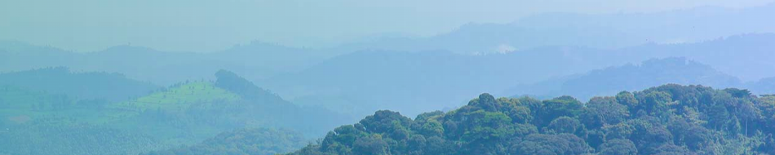
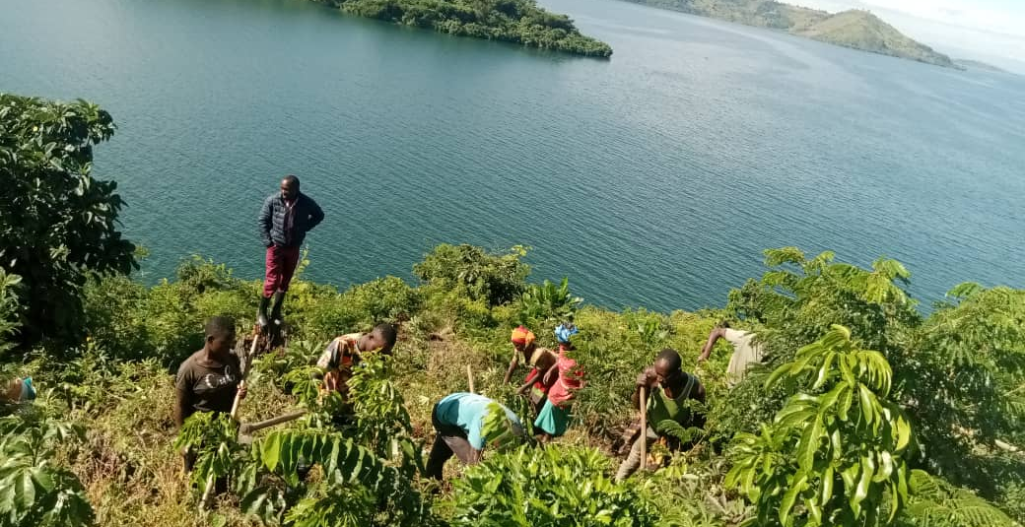
BIOCOOR works to address the degradation of Nyungwe National Park (NNP) by influencing the economic prospects of the people living near NNP and Lake Kivu. BIOCOOR’s projects integrate biodiversity conservation with agriculture, nutrition, environmental management, community health, and ecotourism, all targeted at positively impacting the local economy.
Areas of Focus
Enhancing community awareness of biodiversity conservation
The largest threat to the conservation of the park is the illegal use of resources by communities. BIOCOOR works to educate people on the importance of biodiversity conservation and the impact that the illegal use of resources can have. Through education, local communities become stewards of the park and assist in its protection.
Integrating biodiversity conservation and development projects
BIOCOOR’s projects integrate conservation with human development. Some of BIOCOOR’s past projects have included hiring local community members to remove invasive species from the park or to work in ecotourism.
Improving soil quality and organic farming through agro ecological practices
By educating people on how to improve their soil quality and to use organic farming and agroecology, BIOCOOR provides alternative sources of nutrition, livelihood, and income, to reduce the need to use illegal park resources. This also aims to improve the health of communities in the area.
Community entrepreneurship to inspire business ownership and effective economic development
BIOCOOR trains local people so that they can improve their livelihoods through small business ownership. This includes tailoring, baking, and handicraft and creating cooperatives to help bring goods to a market.
Connecting youth to job training and scholarship opportunities
An essential part of sustainable development is creating opportunities for youth. BIOCOOR provides job training opportunities and scholarships for student studying ecotourism, biodiversity conservation, and environment management.
Training youth to use technology to communicate effectively
BIOCOOR offers youth training in technology, learning how to operate new technologies to communicate and create opportunities for their future.
Educating the youth to access finances and capital
BIOCOOR fosters entrepreneurship by holding training sessions on leadership and development, both in soft skills and in skills needed to start and grow a business. Youth also learn how to access finances and capital to start their own ventures.
Our Centers
Nyungwe Conservation Leadership Center
Empowers local communities, fosters entrepreneurial leadership, and promotes effective natural resource management.
Nyungwe EcoVillage
Provides immersive experiences for visitors to Nyungwe National Park and its surrounding communities in order to support BIOCOOR’s projects.
Nyungwe BioInnovation Center
Serves as a pivotal hub for advancing biodiversity conservation, promoting community health, and addressing climate change challenges.
Ecosystem restoration on Lake Kivu
Learn More
E: info@biocoor.org.rw
P: +250 788 840 755
www.biocoor.org.rw

